Slide 1
Mindful Writing MMTP Sangha
March 10, 2024
Facilitated by Marianela Medrano, PhD

Slide 2

Home and Belonging
Refugia is a scientific term referring to places that become safe spaces for organisms and life to endure in the midst of upheaval.
Querencia in Spanish, evokes how feelings and our deepest beliefs are connected to a sense of place, a sense of belonging. From Querencia we can better understand the possibility of building reciprocal equity as opposed to banking on competitive equity, which is an oxymoron.

Slide 3

The House of Belonging by David Whyte
I awoke
this morning
in the gold light
turning this way
and that
thinking for
a moment
it was one
day
like any other.
But
the veil had gone
from my
darkened heart
and
I thought
it must have been
the quiet
candlelight
that filled my room,
it must have been
the first easy rhythm
with which I breathed
myself to sleep,
it must have been
the prayer I said
speaking to the otherness
of the night.

Slide 4
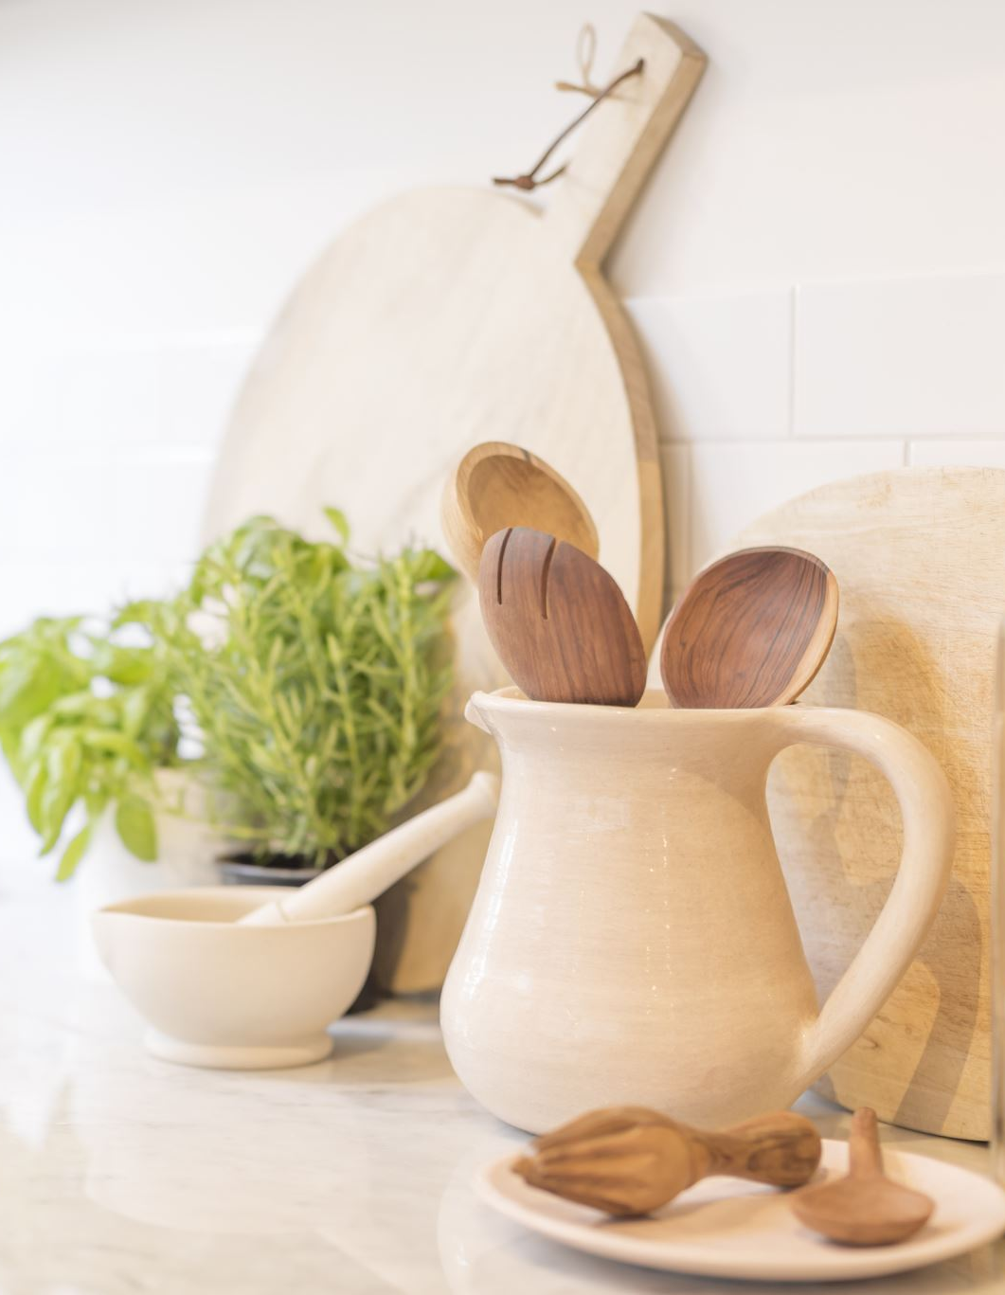
Belonging
And I thought
this is the good day
you could
meet your love,
this is the gray day
someone close
to you could die.
This is the day
you realize
how easily the thread
is broken
between this world
and the next
and I found myself
sitting up
in the quiet pathway
of light,
the tawny
close grained cedar
burning round
me like fire
and all the angels of this housely
heaven ascending
through the first
roof of light
the sun has made.
This is the bright home
in which I live,
this is where
I ask
my friends
to come,
this is where I want
to love all the things
it has taken me so long
to learn to love.
This is the temple
of my adult aloneness
and I belong
to that aloneness
as I belong to my life.
There is no house
like the house of belonging.

