Slide 1
Mindful Writing
Marianela Medrano, PhD
Jan 14, 2024

Slide 2
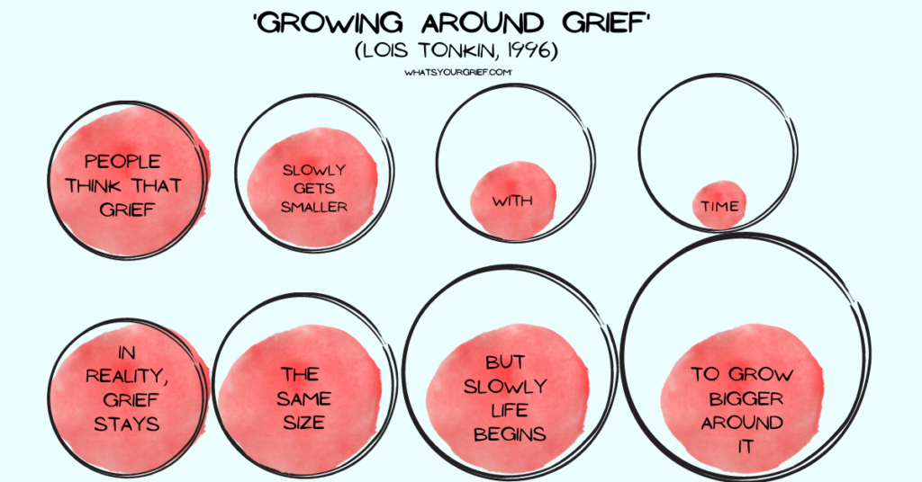
Tonkin’s Model of Grief

Slide 3
How We Take Our Grief by Kimberly Grey
We take our grief privately and in the morning.
And drink our coffee and drink our tea.
We hold the newspaper out with our arms
and we hold the fork that holds the egg that holds
hunger. We put it in our mouth. We put it
in our mouth. Twice the clock strikes three
and privately we sit together. We think
the orange juice is too bright. We pour it
in a glass and think. We drink the brightness
and it disappears. We take the last muffin and
split it into three.

Slide 4
How We Take Our Grief
Our two mouths hold each other.
Privately, we think it’s the mind that holds us.
We sit striking the thought. We hold the clock
that holds the mind. We think the clock is
in our arms. We think the clock is our arms.
Privately, the thought disappears. We pour
the morning. We drink the morning together
and split the brightness. We take the morning
out of us and put it in our mouths. We drink
it. We hold our grief out in front of us.
We think this is private. We take our grief
and pour it in a glass. We think we have
mouths we think we have arms to hold it.

